Slide 1
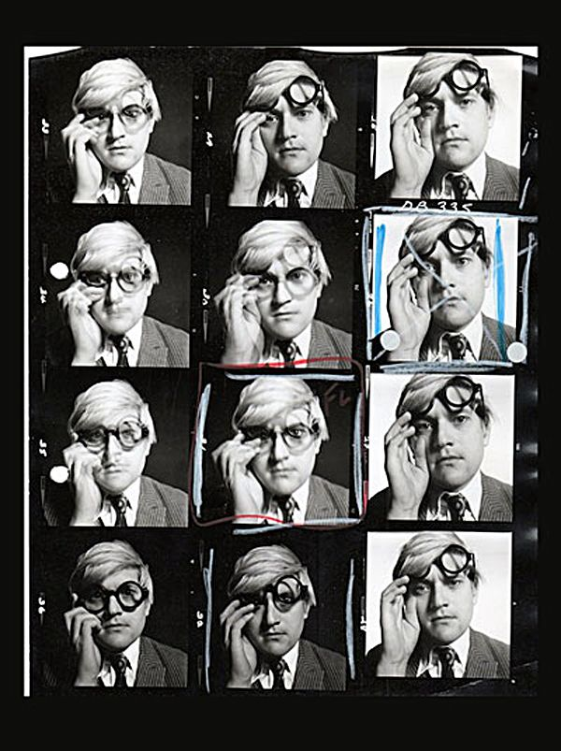
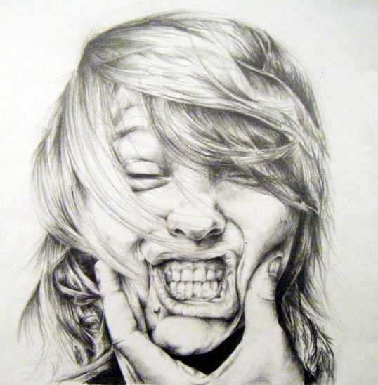
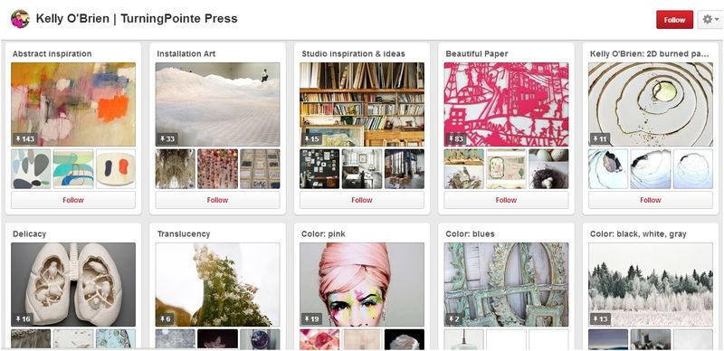
SUMMER TASK LIST A LEVEL ART.
1. TAKE A HIGH QUALITY PHOTO SHOOT. MINIMUM 50 IMAGES BASED ON PORTRAIT. You can use different view points, close ups, expressive shots. Be creative and use ideas from other artists.
2. CREATE A HIGH QUALITY DRAWING BASED OF ONE OF YOUR PHOTOGRAPHS. The drawing must be in either pen or pencil and showcase the best of your technical ability. Please use the full range of tones.
3. MAKE A PINTEREST BOARD OF AT LEAST 50 PINS OF YOUR FAVOURITE WORKS OF ART/INSPIRATION FOR ART. BE READY TO SHARE THIS AT THE START OF THE YEAR. TRY TO FIND EXHIBITING/CURRENT ARTISTS.
Don’t panic if portrait isn’t your strength, the course includes all styles, media and techniques.

